Slide 1
Content based vIdeo segmentatIon
Team Members
Berk Can Özütemiz- Ece Nalçacı -Veli Engin Öztürk
Advisor
Erdoğan Doğdu
Co-Advisor
Roya Choupani

Slide 2
Contents
Introduction
Problem
Previous Work
Application
Solution
References
Demo

Slide 3
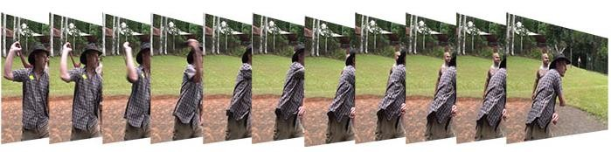
Introduction
Video media is
a sequence of images called frames.
Each frame consists of hundreds of rows and columns. Hence, the main challenge in using video is its huge size.
Video Coding refers to the methods used for
compressing video.
These methods try to reduce or eliminate redundancy in video.

Slide 4
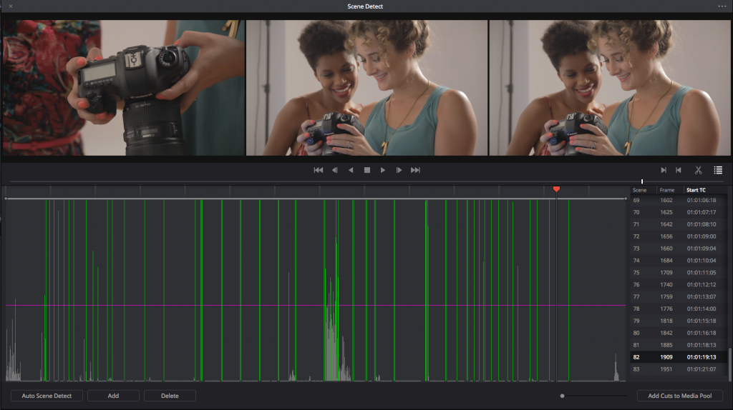
Problem
Video segmentation is a process for dividing a video sequence into shots.
Content Based Video Segmentation Project aims to divide the video into meaningful shots.

Slide 5
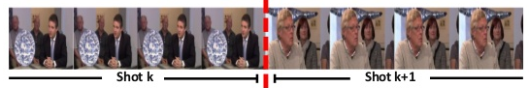
Problem
Video is segmented into shots where each shot is automatically labeled. These labels are later used for retrieving the videos.

Slide 6
Application
Content Based Segmentation is a necessary process in many different applications
Video Summarization
Video Search
Video Annotation

Slide 7
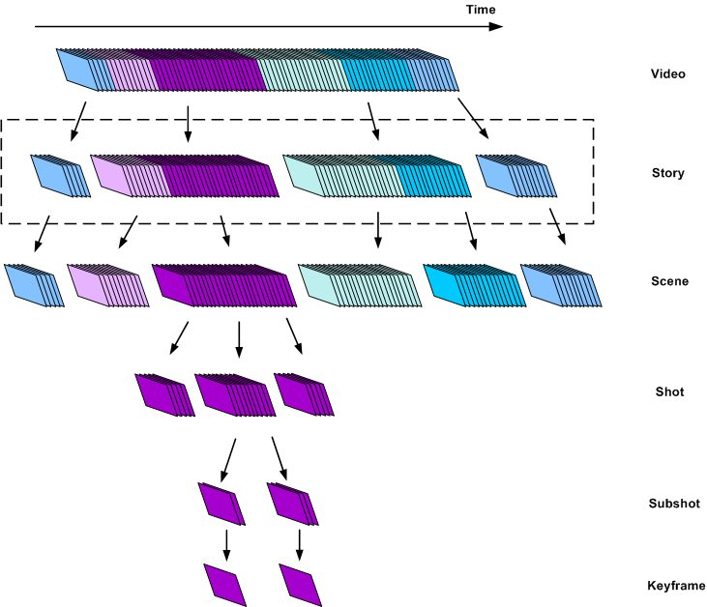
Application

Slide 8
Application
Content Based Video Segmentation will run on all operating systems.
Matlab platform will be used.
C language will be used.

Slide 9
Previous Work
Group
Information Used | [1] | [2] | [3] | [4] | [5] | [6]
DCT coefficients | ✓ |  |  | ✓
DC terms |  | ✓ | ✓
MB coding mode |  |  | ✓ | ✓ | ✓ | ✓
MVs |  |  | ✓ | ✓ | ✓
Bit-rate |  |  |  |  |  | ✓

Slide 10
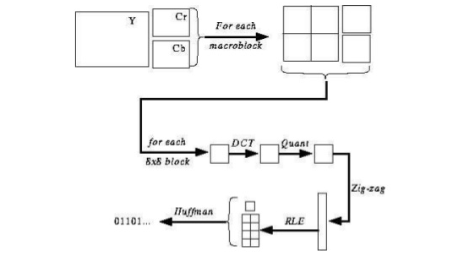
Solution
Intra frame considers each frame of a video as a still image.

Slide 11
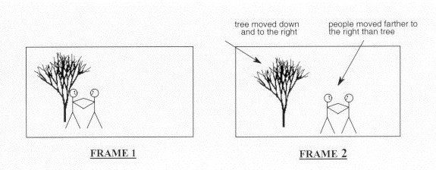
Solution
Inter-frame coding is the process of video compression using motion estimation.
The frames of a video are very similar if the time interval between them is short.

Slide 12
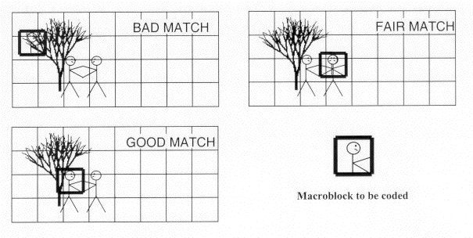
Solution
The goal of motion estimation is finding the most similar area in the reference frame (previous frame) to a block in the current frame.
Similarity is generally defined using Sum of Absolute Difference (SAD)

Slide 13
Solution
Motion Estimation gives a motion vector.
Motion vector is used to find the most similar area in the reference frame.
The most similar area is subtracted from the current block.

Slide 14
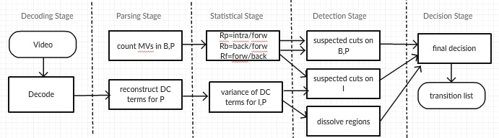
Solution
Temporal Video Segmentation based on DC Terms and MB coding mode algorithm is used.

Slide 15
References
[1] 29. Arman, A. Hsu, M.-Y. Chiu, Image processing on compressed data for large video databases, in: Proceedings of First ACM International Conference on Multimedia, 1993, pp. 267-272. [2] B. Yeo and B. Liu, "Rapid scene analysis on compressed video", IEEE Transactions on Circuits and Systems for Video Technology, vol. 5, no. 6, pp. 533-544, 1995. [3] J. Meng and Y. Juan, "Scene Change Detection in a MPEG Compressed Video Sequence", in International Symposium on Electronic Imaging, San Jose, 2017, pp. 14-25. [4] H. Zhang, C. Low and S. Smoliar, "Video parsing and browsing using compressed data", Multimedia Tools and Applications, vol. 1, no. 1, pp. 89-111, 1995. [5] Koprinska, S. Carrato, Detecting and classifying video shot boundaries in MPEG compressed sequences, in: Proceedings of IX European Signal Processing Conference (EUSIPCO), Rhodes, 1998, pp. 1729-1732. [6]Feng, K.-T. Lo, H. Mehrpour, Scene change detection algorithm for MPEG video sequence, in: Proceedings of International Conference on Image Processing (ICIP'96), Lausanne, 1996
[7] R. Choupani, S. Wong "Video Coding and Transcoding: A Review". Retrieved November, 2017 Available: http://www.ce.ewi.tudelft.nl/choupani/
[8] M. Wang and H.-J. Zhang, “Video Content Structuring,” Scholarpedia. [Online]. Available: http://www.scholarpedia.org/article/Video_Content_Structuring. [Accessed: 15-Jan-2018]

Slide 16
Demo

Slide 17
Thank you for listening

